Slide 1
Project A Single Cell RNA Sequencing
Short Read 2024

Slide 2
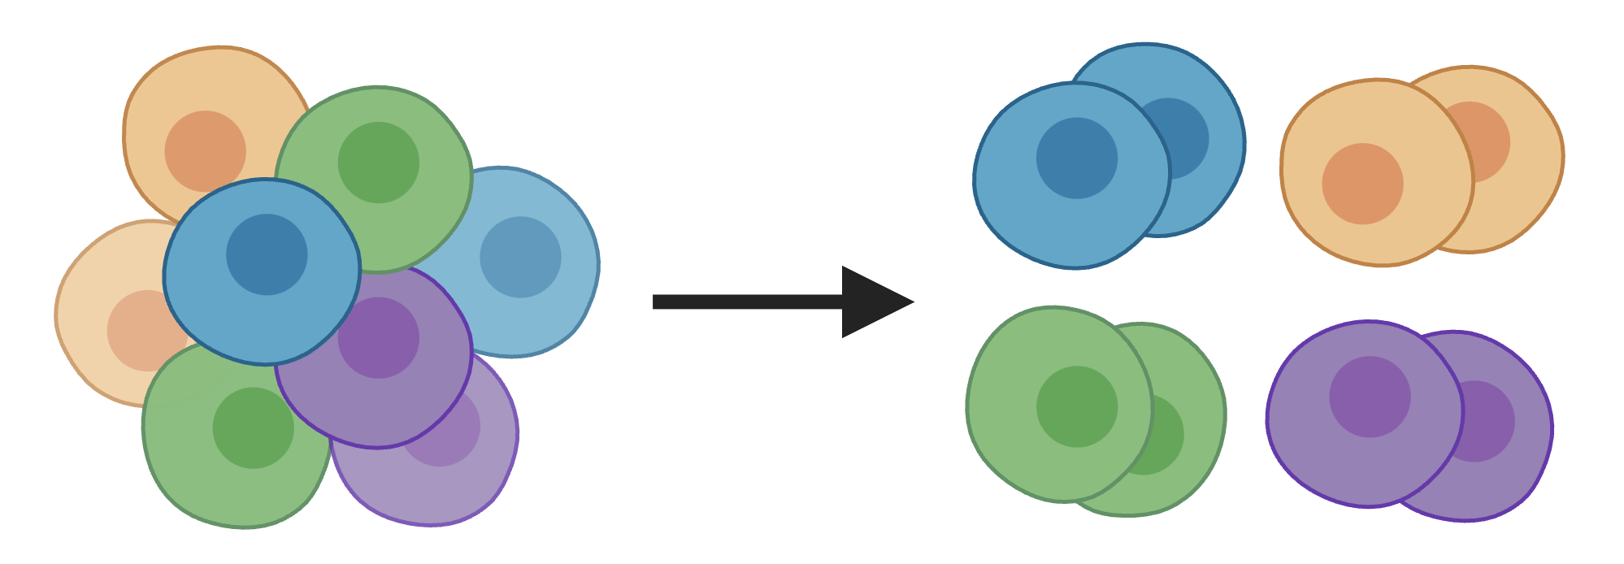
Single cell RNA sequencing is the gold standard method for determining cell types in a heterogeneous population of cells
Cell Type?
Cell Type?
Cell Type?
Cell Type?

Slide 3
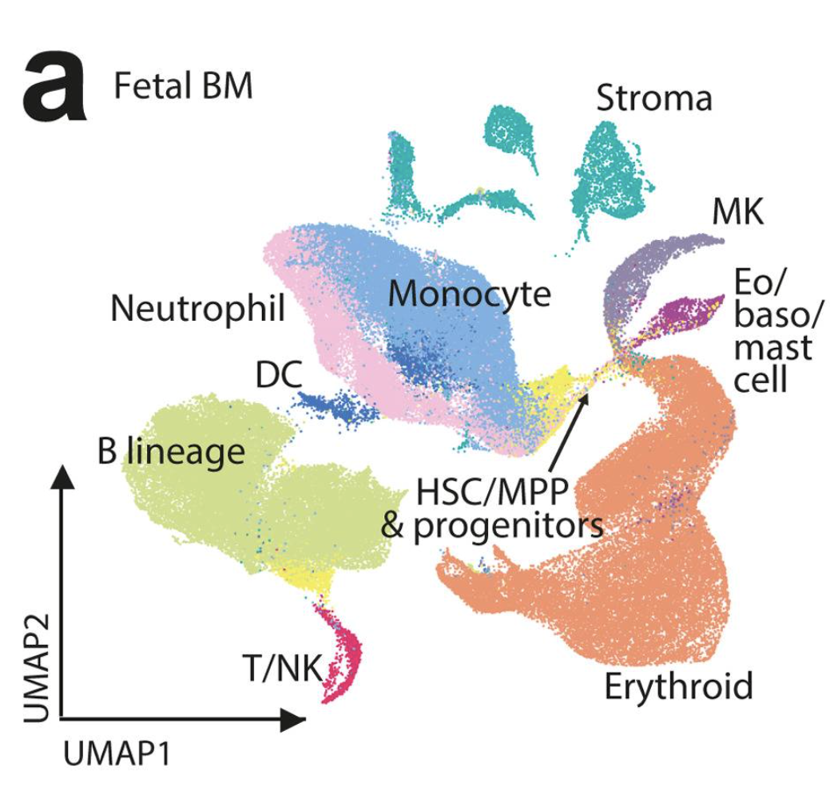
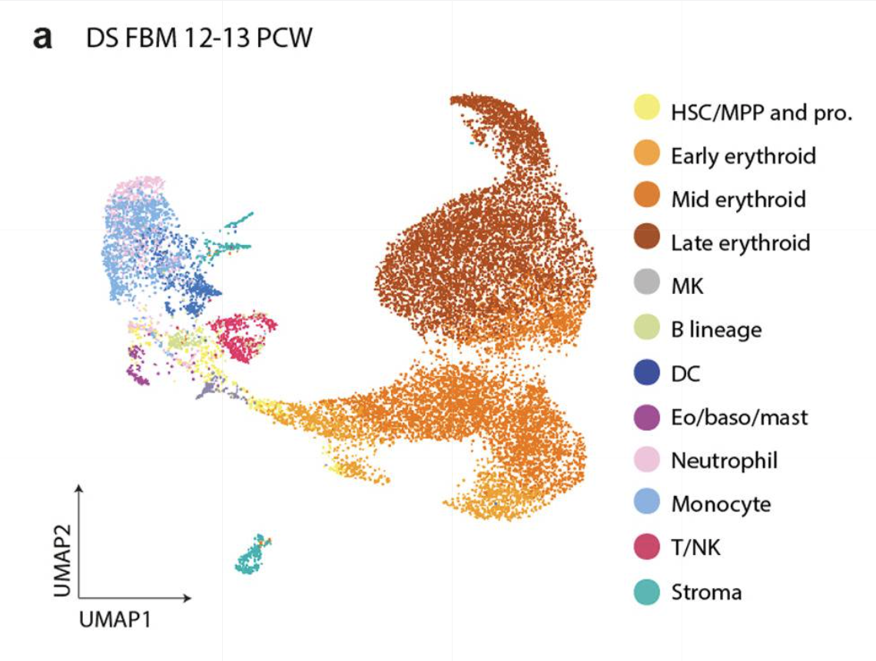
Down syndrome fetal bone marrow has different proportions of blood cell types compared to typicals
L. Jardine, S. Webb, et al. 2021

Slide 4
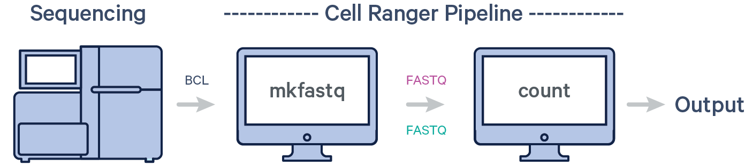
10X Genomics Cell Ranger Pipeline
(Output files for Seurat)

Slide 5
Worksheet 1: Cell Ranger
(Output files for Seurat)
**Mapping with Cell Ranger Count

Slide 6
Today part 1
Go to worksheet 1 on github
Modify sbatch script, run Cellranger Count, check that it is running for at least a 1 minute (no errors)
Green sticky and move onto worksheet 2

Slide 7
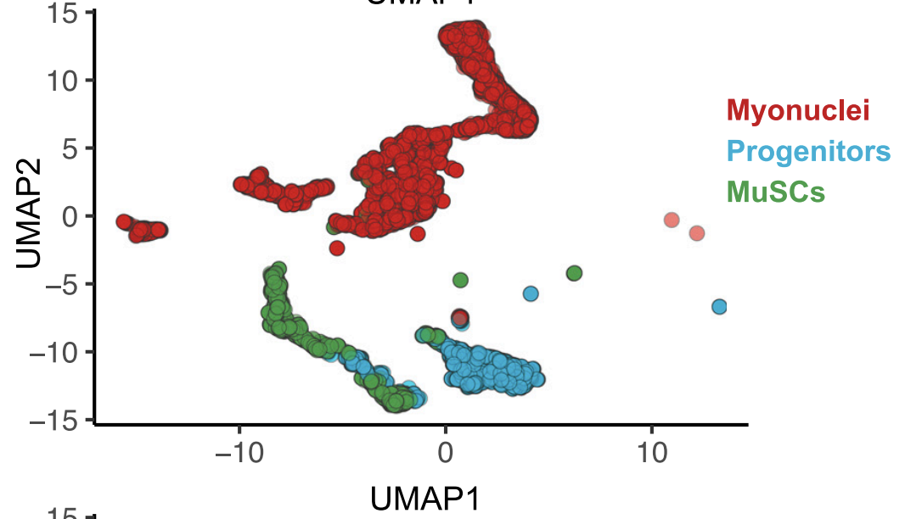
scRNA-seq workflow
Alignment
Normalization, scaling, dimensional reduction
Cluster visualization, differential expression, additional analysis
Pseudotime, pathway analysis, etc.
Cellranger
Seurat (R)

Slide 8


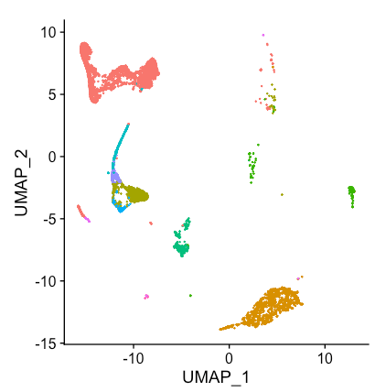
Seurat
Remove debris/doublets
A Sunday Afternoon on the Island of La Grande Jatte, Georges Seurat (1884)
Normalization
Scaledata
Myonuclei
“…named for Georges Seurat to invoke the analogy between the intricate spatial patterning of single cells and a pointillist painting.” (doi: 10.1038/nbt.3192)
PCA
Stem
cells
Immune
UMAP/clustering
Schwann
Smooth
muscle
FAPs

Slide 9
Seurat workflow
Processing individual
Seurat objects
Integrating
Seurat objects
Plotting and clustering
Add metadata
Merge Seurat objects
Normalize data
Find genes with variable gene expression
Scale data
Run PCA reduction
Split Seurat objects and identify anchors (genes) to “integrate” objects
UMAP reduction and visualization

Slide 10
Today part 2
Go to worksheet 2 on github
Read in files from Cellranger from AWS and generate Seurat objects in R
Conduct quality control, pre-process data, and integrate Seurat objects

